Slide 1


Slide 2






Embracing Uniqueness
Enabling Environments
Communication
Culture
Relational Approach
Vision, Values, Purpose, Cornerstones
Notes:
Student Journey – new student transitioning in, consultation approach, in person relational approach to visits, pre assessment (including academic and communication levels) ensuring the support it pitched to the right level from the beginning, sensory profiles fitting in with one page profiles/student passports etc

Slide 3

Our Mission
We are committed to inspiring and enabling our students, delivering meaningful skills for life in a holistic, nurturing, and stimulating learning environment. This is achieved through exceptional teaching, unwavering support, outstanding work experience, and positive interactions and role models. We encourage resilience, independence, confidence, and wellbeing in all of our students.
By holding the highest of ambitions for our children, we shine a light on their potential to lead the brightest of futures.

Slide 4


When
Inspiring Brighter Futures
Lighthouse School Harrogate is a specialist free school, educating autistic children and young people aged between 11 and 19 who are able to access a KS3, KS4 or KS5 curriculum at or around the corresponding age range for that curriculum.

Slide 5
When
When will Lighthouse School Harrogate open?
As successful transitions are important and take time, we will be offering a comprehensive transition package during November and December for those students who will be joining us in January.
This will also give us an opportunity to ensure that training has been provided to all of our new staff to understand the 'Lighthouse Way'.
Information about transition will be provided to students and their families once we have been named as their education provision.
This is likely to include meetings with students and their families, a Speech and Language Therapy (SaLT) assessment, individual tours, small group work, building to whole class lessons.
By Wednesday 6th January 2027 the full, broad, varied and supportive timetable will be in place.

Slide 6
When
How will Lighthouse School Harrogate grow?
In September 2027 we will have 48 students in total.
This will comprise the 24 students who joined us in January 2027 in Key Stage 3, plus 12 students into the new Year 7 cohort (currently Year 6s) and we anticipate that we will also be offering 12 places in Key Stage 4.
In September 2028 we will have 80 students in total.
This will comprise students from Year 7 to Year 13.

Slide 7
When
Our staff team
CEO / Executive Principal Principal Deputy Principal Assistant Principal Teacher Wellbeing Coordinator | Emma Sullivan Jo Tunnicliffe Jennifer Blunstone Ben Fraser-Smith Hannah Edmonds Laurie Jones
Teachers, Wellbeing Tutors, Teaching Assistants, Administrators and Site team are all in the process of being recruited.

Slide 8
When
What does the Lighthouse School Harrogate site look like?
The final touches are currently being undertaken to the building works on the site. We will shortly be publishing some photos on this presentation and online so that you can see what the school looks like.
We will also be hosting open events on site in November and December for young people and families.
If you are interested in our open events please complete the Expressions of Interest form on the Lighthouse School Leeds website in the Key Information section under Admissions and Prospectus and we will be in touch as soon as we have set the dates and times for these events.

Slide 9
When
What are the term dates?
Spring Term 2027
Tuesday 5th January | Staff training day
Wednesday 6th January | First day of term for students
Monday 8th February - Friday 12th February | Half term
Friday 19th March | Last day of term
Monday 22nd March - Friday 2nd April | Easter holidays (Good Friday 26th March & Easter Monday 29th March)
Summer Term 2027
Monday 5th April | First day of term for staff and students
Monday 31st May - Friday 4th June | Half term Bank Holidays on 3rd & 31st May
Thursday 23rd July | Last day of term for students
Friday 24th July | Staff training day (Monday 26th July is a disaggregated staff training day)

Slide 10
School Day
The school day will start at 8:45am and finish at 3:15pm
On Wednesdays the school day will finish at 2:15pm for students.
This is to facilitate ongoing staff training and development and, in the longer term, to offer an exciting enrichment and extra-curricular programme for students.

Slide 11
School Day
Time | Activity
8.45am | School starts/student arrive / Breakfast Club
9.00am | Form time
9.15am | Period 1
10.15am | Period 2
11.15am | Break time
11.30am | Period 3
12.30pm | Lunch time
1.00pm | Period 4
2.00pm | Period 5
3.00pm | Check out / Reading
3.15pm | School day ends/students leave site

Slide 12
LET's Learn - Cornerstones
Curriculum
Wellbeing
Individual student and their EHCP​
SaLT and
Communication
Skills and Experience
Notes:
How the Lighthouse Approach works in school?
What it looks like in practice?
A student journey?

Slide 13
Teaching and Curriculum Delivery
Students will be taught in small groups of approximately 12 students.
Secondary model (students move to subject teachers and spaces)
Our curriculum is delivered through a range of subjects and activities that are designed in a student-centered way
Students follow a two-week timetable (Week A/Week B)
Notes:
Lynn

Slide 14
Curriculum Offer – KS3
English
Mathematics
Science
PE
Personal Social Health Education (PSHE)
Computing
History
Geography
Religion, Ethics, Philosophy (REP)
Art
Music
Food Technology
Preparation for Adulthood
Wellbeing
Ambition | Versatility | Compassion | Innovation | Happiness | Devotion | Optimism | Respect
Notes:
Lynn

Slide 15
Preparation for Adulthood*
Community Skills
Future Skills
Independent Life Skills
Wellbeing
Communication & Interaction
*from the NEN framework & PfA Guidance

Slide 16

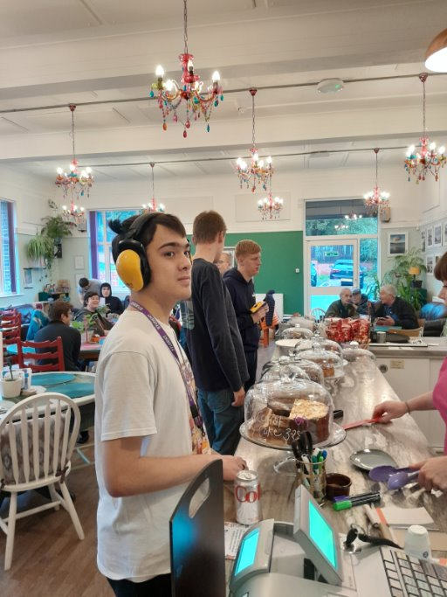
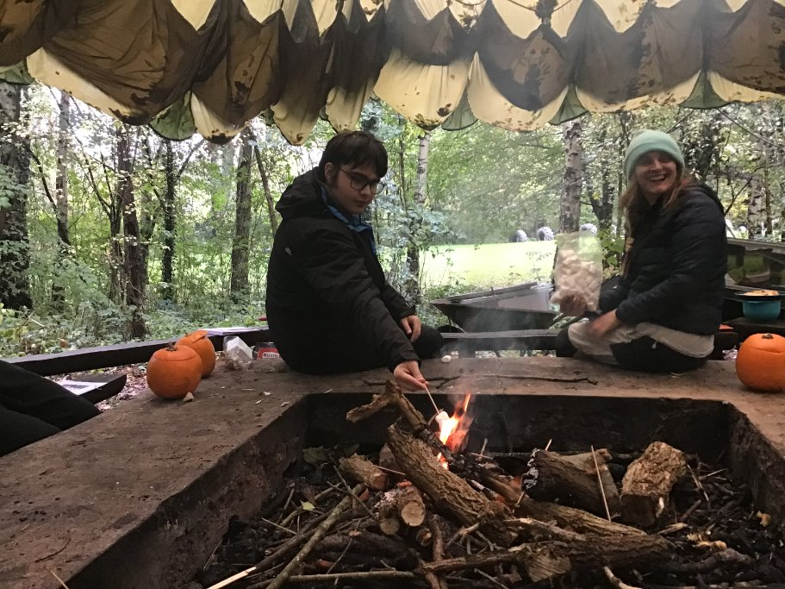
Skills and Experiences Curriculum
Careers Education Information Advice
& Guidance
Community skills
Independent living skills
Future skills & employability
Work related learning
Work experience
Enrichment & enterprise activities
Curriculum & cultural visits
Individualised provision & support
Along with:
Comprehensive careers programme
Strong College and University partnerships
Effective employer engagement
Transition support into secure next step pathways
Preparation for Adulthood
Destination-led curriculum

Slide 17
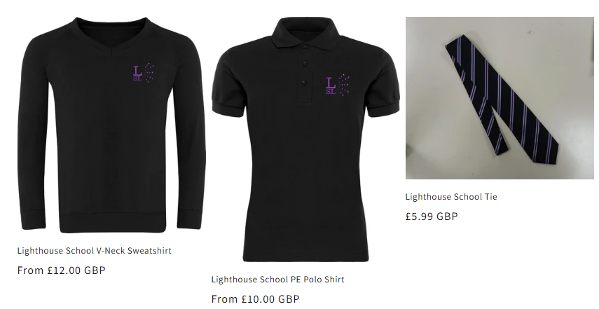
School Uniform
School tie
Black sweatshirt with school logo or
School blazer
White cotton shirt or white polo shirt (unbranded)
Black trousers/Black skirt/Black shorts (unbranded)
Black school shoes or ankle length boots (flat and plain)
We are currently working with suppliers and will confirm who our suppliers will be shortly.
We understand that some of our students have sensory aversions to or preferences for certain fabrics and that this can impact them on a day-to-day basis. At Lighthouse we endeavour to support these students to explore adaptations to our uniform that still follow guidelines where possible, to help them feel safe and secure in school. We welcome discussions with students, parents and carers around this matter where needed.

Slide 18
School PE Kit
Black polo shirt (with school logo)
Black shorts (unbranded)
Black sports socks (unbranded)
Black tracksuit or jogging bottoms (unbranded)
Training shoes (unbranded)
Students will be made aware of when their timetabled PE days are.
Students are able to come to school in their PE kits on the days they have PE.

Slide 19
School Lunches
Students can have a school lunch or bring their own packed lunch.
Quieter areas are available in school for students to eat their lunch.
Menus will be available shortly.
Notes:
Lynn

Slide 20
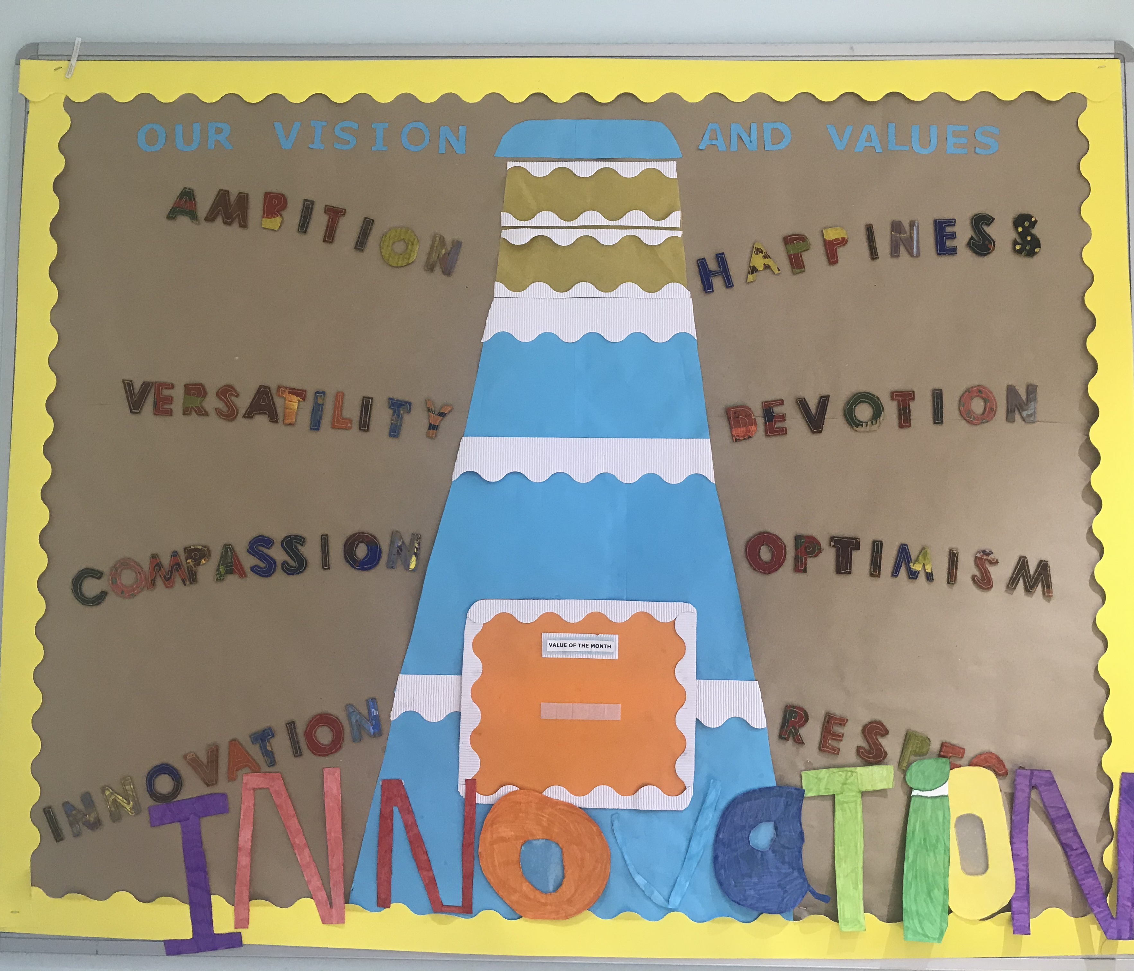
Inspiring Bright Futures
We are committed to meeting the personal aspirations of our students and their families.
Our aim is to help students to develop meaningful skills for life in a safe and caring environment where they will get the most out of learning and grow in confidence.
Every day we will put excellence at the heart of everything we do to ensure the best for our students.
Notes:
Emma/SLT

Slide 21
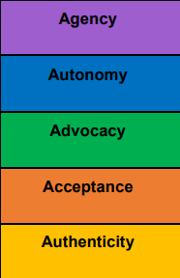
Communication Provision (SaLT)
Baseline assessment for all students
Further assessment and progress monitoring for students on and off the SALT caseload
Supporting students with understanding and/or using language
Targeted group sessions and interventions
Specialist 1:1 therapy for specific students e.g. selective mutism
Celebrating neurodiversity and understanding differences in communication styles
Developing and supporting alternative forms of communication
Supporting student voice, self-advocacy and functional skills
Notes:
Josh

Slide 22
Wellbeing provision
Social Understanding & Relationships
At Lighthouse, we focus on building your child’s emotional and social wellbeing in order to raise their self-esteem and promote an inclusive and accepting environment for learning.
Aim to enhance each young person's emotional literacy skills and support their mental health.
Individualise support as much as possible to meet student needs as well as we can.
Provide exciting extra -curricular opportunities through the SHINE provision
Deliver a meaningful curriculum of taught sessions for all students using the NEN framework.
Provide training and support to the wider school team to ensure that the provision is consistent and meets the needs of all.
Emotional Understanding & Self Awareness
Interests, Routines & Processing
Sensory Processing
Notes:
Wellbeing Toolkit
CBT Therapeutic approaches
Building resilience
Anxiety management
Interventions & Mentoring
Emotional Literacy
Therapeutic Sessions
Relaxation
Social Stories
Visual Support

Slide 23

Parent Support – Teen Life
The National Autistic Society (NAS) Teen Life parent support programme is available at Lighthouse School.
This is a six-week parent support programme which will run weekly from the school training suite. The programme will allow you to explore support strategies for your autistic child.
The sessions are interactive. It allows you to request a supporting professional e.g. PA, support staff to attend the sessions with you and be part of the discussions around your child.
Notes:
Tracy

Slide 24

Beacon Family Support
Beacon is the name we use for all the family support offered in school.
Families can access:
Signposting to support
Guidance on services, resources and organisations that can help you.
Support from other parents
Opportunities to talk, share experiences and learn from one another.
Social events
Friendly gatherings to help build our school community.
Parent Hub information sessions
Useful workshops and sessions on topics that matter to you.
A closed Facebook group for Lighthouse School parents and carers
A safe, private space to connect and share with other families.
Notes:
Tracy/FLO

Slide 25
Policies
The website for Lighthouse School Harrogate is currently under construction and will be published shortly.
In the meantime our policies can be found in the policies section of the Lighthouse School Leeds website.
Notes:
Nat

Slide 26
Support for families with admissions
Students at Lighthouse are working at or around age related expectations ​
Make sure the EHCP is accurate, ask for an annual review​
The LA will consult your preferred schools with the up to date EHCP
If you are interested in a place at Lighthouse School Harrogate, please contact your local authority caseworker and the SENDCo at your child's current school.

Slide 27
Support for families with admissions
It is ultimately a local authority's decision whether to name a school in an EHC plan
We do not hold a waiting list
There is a separate consultation process for each school within the trust
The final EHC plan is your formal notification of the LA's decision
Our admissions policy and guidance is on the Lighthouse School Leeds website, in the Harrogate school section.

Slide 28
Questions
If you have any further questions, please email admin@lighthouseschool.co.uk who will pass your query onto a member of the Lighthouse School Harrogate team.
If you are interested in our open events please complete the Expressions of Interest form on the Lighthouse School Leeds website in the Key Information section under Admissions and Prospectus and we will be in touch as soon as we have set the dates and times for these events.
Notes:
Nat

